Slide 1
Description | GPT output | Our input in GPT code | %wise code written by us vs GPT | Time Saved | Challenges faced | ChatGPT (Screen Shots or Word Files Attached)
Use Case Micro Service and API | GPT gives output which is 60% accurate | More research was needed to fit the GPT code to our requirement. | 60% of GPT code was used. | If developed manually these could have taken around 10 days of completion as against 2 days on using ChatGPT | Genie (ChatGPT extension ) was not working, server down most of the time in free-tier application
Use Case Dependency Injection | Generated output with 60% accuracy | We had to do more research on how to register services in startup class on a console application | 60% of the GPT code was used | Using ChatGPT it took us around 1.5 days to build the design pattern with the API Controller attribute. If doing Manually it would have taken around 5 days for the same. | Genie (ChatGPT extension ) was not working, server down most of the time in free-tier application
Use Case Monthly/Quarterly/Yearly claims submission vs approvals | Exact code with 90% accuracy | We had to manually change the ChatGPT code to meet our requirement. | 90% of the GPT code was used | 3 hours | Genie (ChatGPT extension ) was not working, server down most of the time in free-tier application .

Slide 2
Description | GPT output | Our input in GPT code | %wise code written by us vs GPT | Time Saved | Challenges faced | ChatGPT (Screen Shots or Word Files Attached)
Use Case Validating excel file | Generated code with 90% accuracy | We had to tweak GPT code little bit because of implementation of Dependency Injection. | 90% of the GPT code was used. | If manually it would have taken 2 hours to reach the approx. same solution. | Genie (ChatGPT extension ) was not working, server down most of the time in free-tier application
Use Case: Date and Amount Validation | The final output gave me a good enough code with a valid logic statement to implement validations. | Changing the cells to be searched, passing cell object to validation function | 85% written by GPT | Would have taken 2-3 hrs was able to complete in an hour | None
Use Case: File format check (No. of column and Column Names) Validation | The final output gives a good enough code with a valid logic statement to implement . | Compare the actual and expected columns name using XLWorkbook in c# | 85% written by GPT | Would have taken 2-3 hrs manually | None

Slide 3
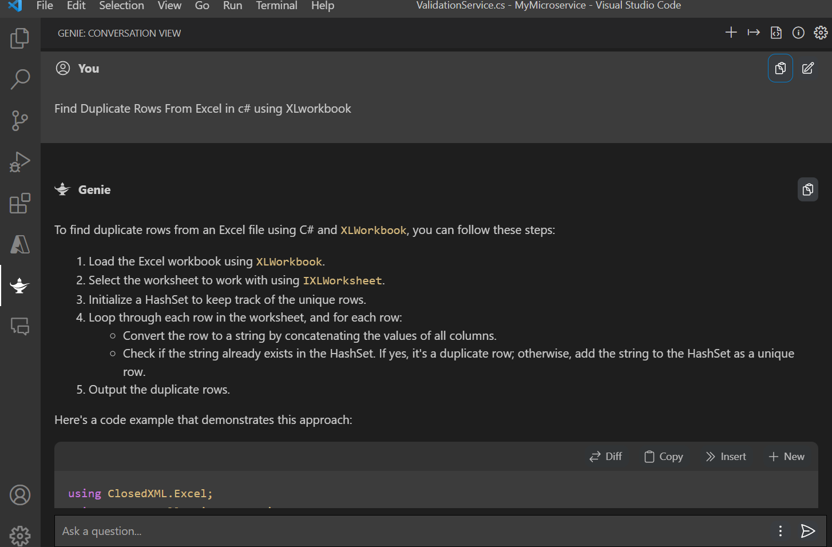
Description | GPT output | Our input in GPT code | %wise code written by us vs GPT | Time Saved | Challenges faced | ChatGPT (Screen Shots or Word Files Attached)
Use Case: Data duplicity Validation | The final output gave me a good enough code with a valid logic statement to implement . | We had to tweak GPT code little bit because of implementation of Dependency Injection. | 80% written by GPT | Would have taken 2-3 hrs manually | None
Use Case: Category wise total approved claim amount | Generated code with 75% accuracy | Changing the cells to be required with the modifications in the LINQ query | 80% of the GPT code was used | Overall the time got reduced by 1.5 days for the task | Have to go in-depth with LINQ queries for the desirable output.
Use Case: Collaboration with the use of Git & GitHub | Generated the commands required for establishing project on GitHub. | Make use of the commands which were required for the particular situation. | 95% of the GPT code was used. | Saved the time by 2 hours. | Initially when branches were created and while pushing code we got branch error and this took us a while to resolve

